Slide 1
ARM Architecture & Pipeline

Slide 2
ARM Architecture
Typical RISC architecture:
Large uniform register file
Load/store architecture
Simple addressing modes
Uniform and fixed-length instruction fields

Slide 3
ARM Architecture (2)
Enhancements:
Each instruction controls the ALU and shifter
Auto-increment and auto-decrement addressing modes
Multiple Load/Store
Conditional execution

Slide 4
ARM Architecture (3)
Results:
High performance
Low code size
Low power consumption
Low silicon area

Slide 5
Pipeline
In General

Slide 6
Sequence of steps involved in the execution of an instruction
Fetch the instruction from memory (fetch).
Decode it to see what sort of instruction it is (dec).
Access any operands that may be required from the register bank (reg).
Combine the operands to form the result or a memory address (ALU).
Access memory for a data operand, if necessary (mem).
Write the result back to the register bank (res).

Slide 7
These steps tend to use different hardware functions, for instance the ALU is probably only used in step 4.
Therefore, if an instruction does not start before its predecessor has finished, only a small proportion of the processor hardware will be in use in any step
An obvious way to improve the utilization of the hardware resources, and also the processor throughput, would be to start the next instruction before the current one has finished. This technique is called pipelining

Slide 8
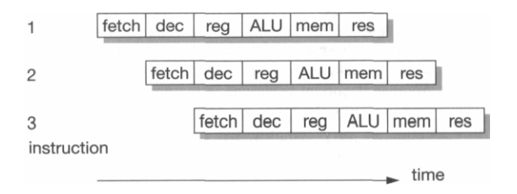
Pipelined instruction execution

Slide 9
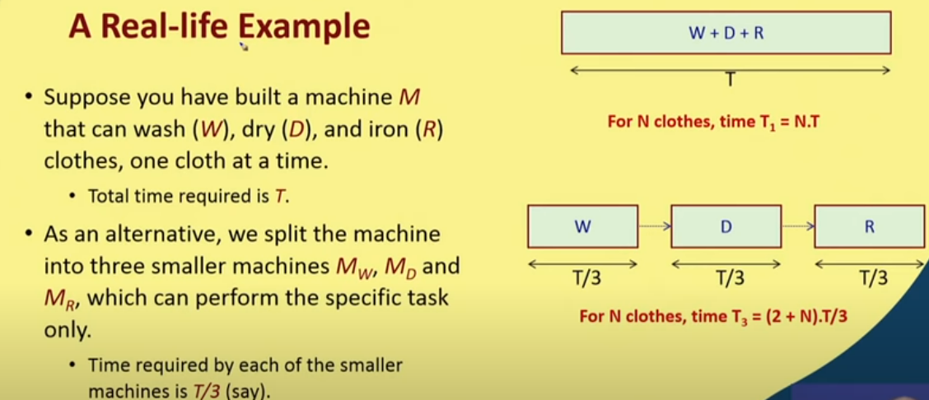

Slide 10
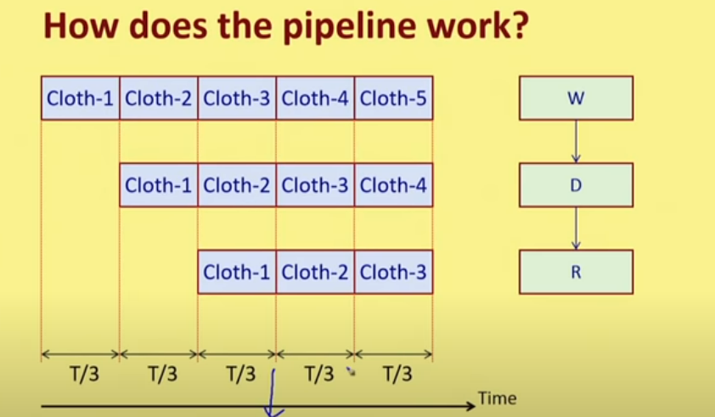
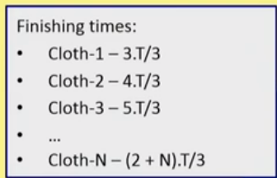

Slide 11
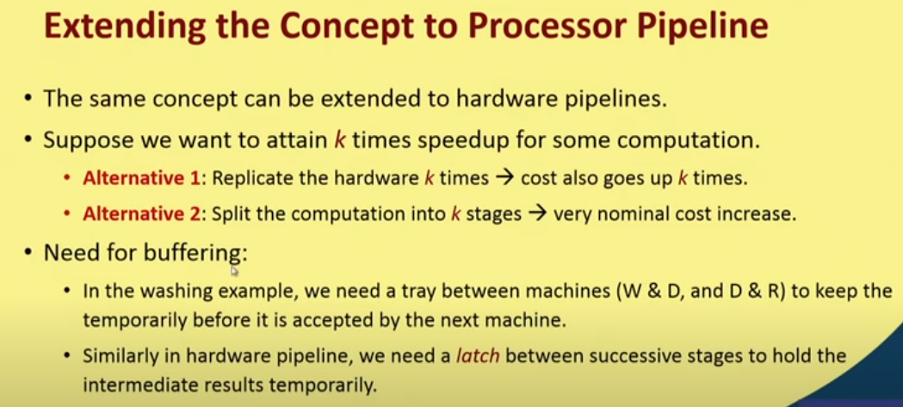

Slide 12
Pipeline Organization
Increases speed :
Most instructions executed in single cycle
Versions:
3-stage (ARM7TDMI and earlier)
5-stage (ARMS, ARM9TDMI)
6-stage (ARM10TDMI)
8-stage(ARM 11)
Notes:
Pipeline is the mechanism used by the RISC processor to execute instructions at an increased speed. This pipeline mechanism speeds up execution by fetching the next instruction while other instructions are being decoded and executed

Slide 13
3-Stage Pipeline
ARM 7

Slide 14
3-stage Pipeline ARM Organization
Register bank
2 read port
1 write port
1 PC write port
1 PC read port
Shifter, ALU, Address register, incrementer, data registers, Decode & control logic
Notes:
Explanation in Furber

Slide 15
Pipeline Organization
3-stage pipeline: Fetch – Decode - Execute
Three-cycle latency, one instruction per cycle throughput
instruction
i
Fetch
Decode
Execute
i+1
Fetch
Decode
Execute
i+2
Fetch
Decode
Execute
cycle
t
t+1
t+2
t+3
t+4
Notes:
During the execution of an instruction ,the processor Fetches the instruction .It means loads an instruction from memory. And decodes the instruction i.e identifies the instruction to be executed and finally Executes the instruction and writes the result back to a register

Slide 16
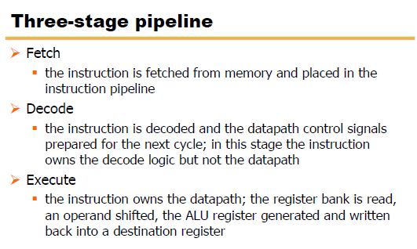

Slide 17
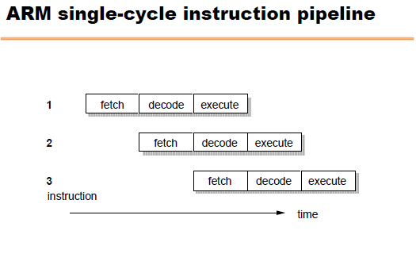
Latency: 3 cycles
Throughput: 1 instruction/cycle

Slide 18
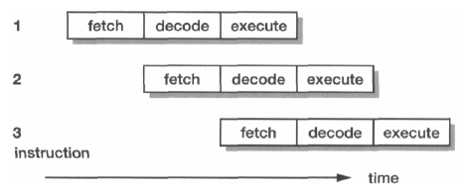
STAGES:
Fetch
Instruction taken from memory
Decode
Decode the fetched instruction and generate control signals for next cycle
Execute
Read register bank (shift if necessary)
ALU result generated
Write back to register

Slide 19
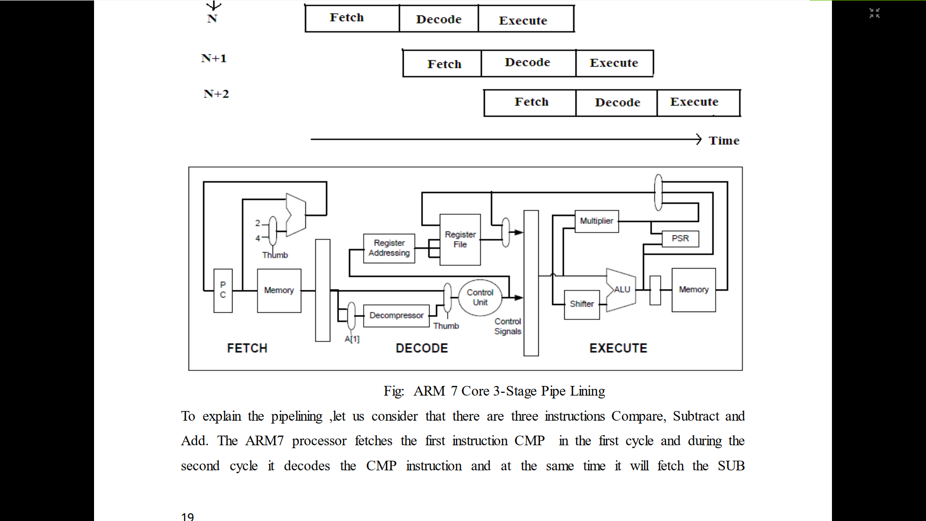
Notes:
Reference :PDF shared for ARM Intro – ARM processors Architecture

Slide 20
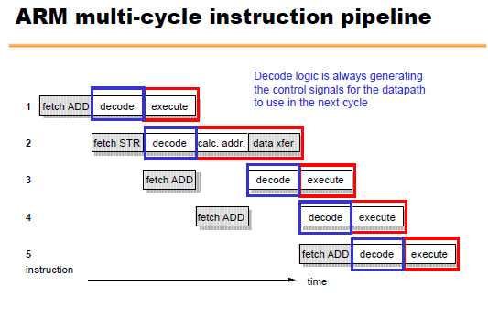
Notes:
Explanation given

Slide 21
Five stage Pipelining
ARM9TDMI

Slide 22
Pipeline Organization
5-stage pipeline:
Reduces work per cycle =>
allows higher clock frequency
Separates data and instruction memory => reduction of CPI (average number of clock Cycles Per Instruction)
Stages:
Fetch
Decode
Execute
Buffer/data
Write-back

Slide 23
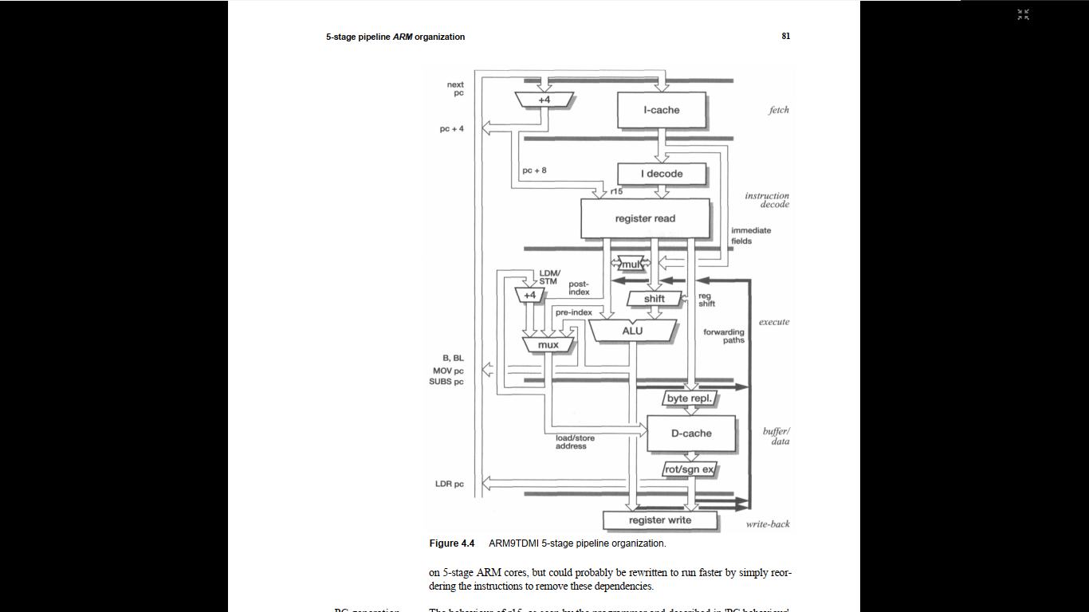

Slide 24
The ARM processors which use a 5-stage pipeline have the following pipeline stages:
Fetch - the instruction is fetched from memory and placed in the instruction pipeline.
Decode - the instruction is decoded and register operands read from the register file. There are three operand read ports in the register file, so most ARM instructions can source all their operands in one cycle
Execute - an operand is shifted and the ALU result generated. If the instruction is a load or store the memory address is computed in the ALU.
Buffer/data - data memory is accessed if required. Otherwise the ALU result is simply buffered for one clock cycle to give the same pipeline flow for all instructions.
Write-back - the results generated by the instruction are written back to the register file, including any data loaded from memory.

Slide 25
Pipeline Organization
Pipeline flushed and refilled on branch,
causing execution to slow down
Special features in instruction set
eliminate small jumps in code
to obtain the best flow through pipeline

Slide 26
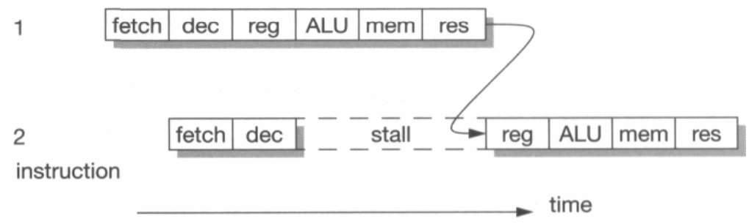
Pipeline Hazards
The result from one instruction is used as an operand by the next instruction.
When this occurs the pipeline operation breaks down, since the result of instruction 1 is not available at the time that instruction 2 collects its operands.
Instruction 2 must therefore stall until the result is available, giving the behavior.
This is a read-after-write pipeline hazard.

Slide 27
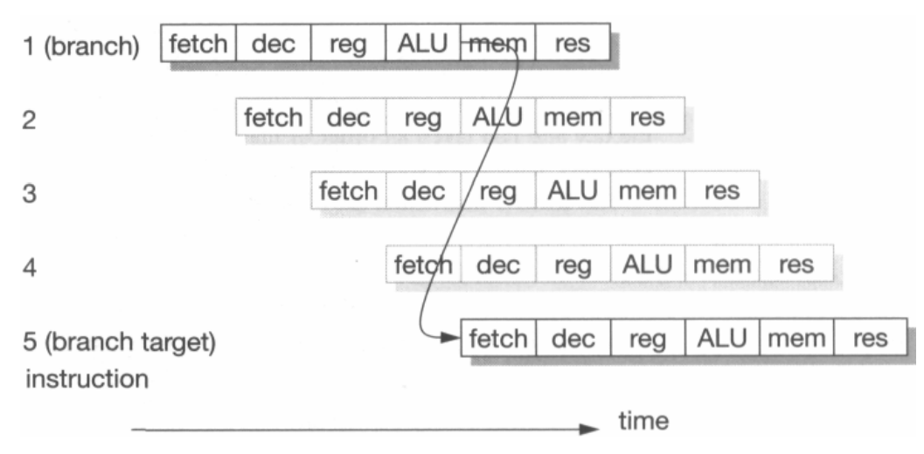
Branch instruction

Slide 28
Thank You!

